Slide 1
Mehak Rafiq
Deficiency disorders of immunoglobulins

Slide 2
Deficiency disorders of immunoglobulins:
There are several other rare , but nevertheless well-described immunoglobulins deficiency disorders .Many of these disorders are include abnormalities in the cell responsible for generating or maintaining an antibody response. Similarly some disorders are
SPECIFIC ANTIBODYDEFICIENCY (SAD)
COMMON VARIABLE IMMUNE DEFICIENCY (CVID)
SELECTIVE IgA DEFICIENCY
HYPER IgM SYNDROME
HEAVY CHAIN DEFICIENCY
KAPPA CHAIN DEFICIENCY

Slide 3
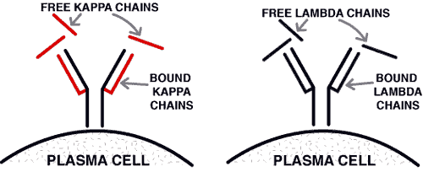
1: kappa chain deficiency:
This Ig light chain deficiency is herited from both parent.
The infection may be due to reduced activation of B-cells.
They make antibody and variety of antibodies.

Slide 4
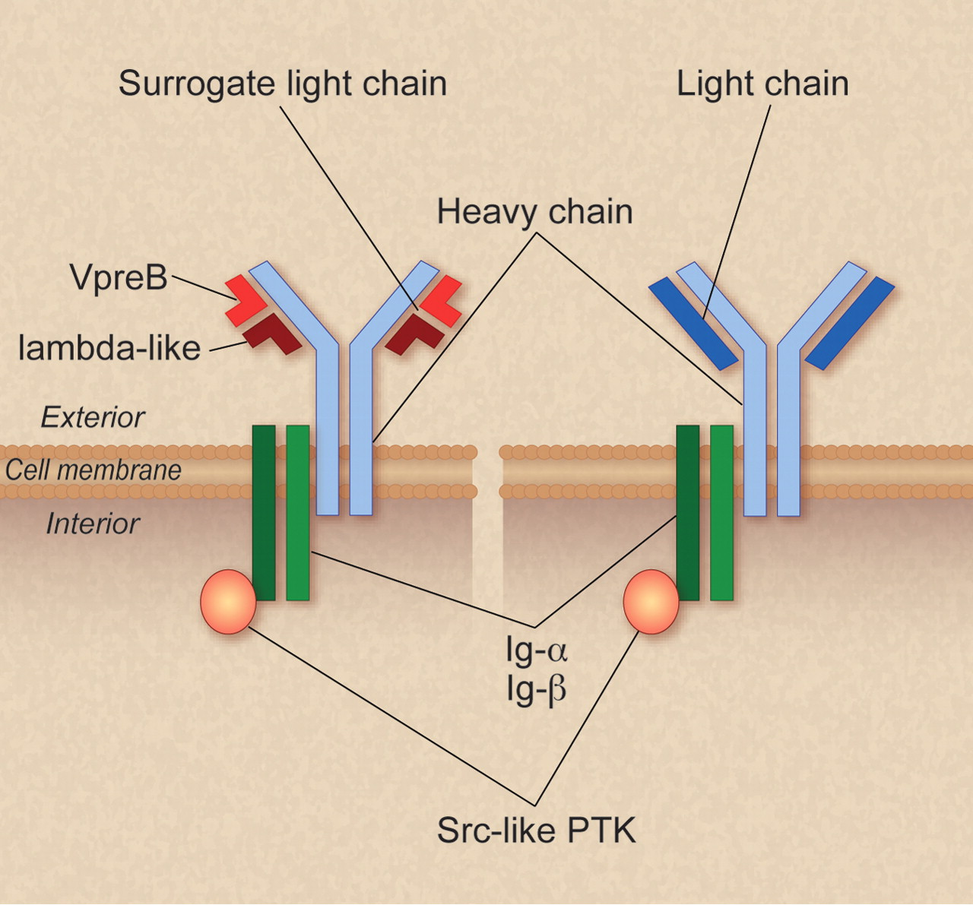
2: heavy chain deficiency:
The multiple genes that codes different immunoglobulins like IgA, IgG1, IgG2 etc.
In rare individuals they may be missing.
They make few types of immunoglobulins IgM, IgG3.
They exhibit susceptibility to respiratory and other infections.

Slide 5
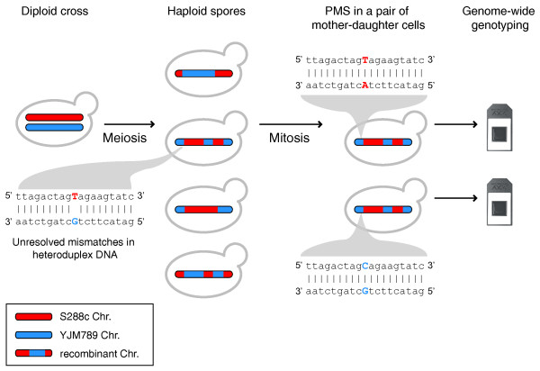
3: post meiotic segregation (pms2)
PMS2 gene mutation leads to detective Ig class switch from IgM, IgG, IgA.
It is rare in primary immunodeficiency.
In resulting low serum IgG and IgA with elevated serum IgM.
In this disorder spots on skin and patient have a predisposition.

